Slide 1
Team 10

Slide 2
Materials You Will Need:
Two 2Liter Coke Bottles
Scissors or Exacto Knife
String
Cardboard

Slide 3
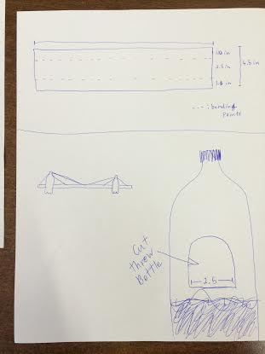
Here are some picture Examples!!!

Slide 4
Cardboard
Width : 4.5in== 1in,2.5in,1in as shown in the picture.
Length : 30in is our estimation.

Slide 5
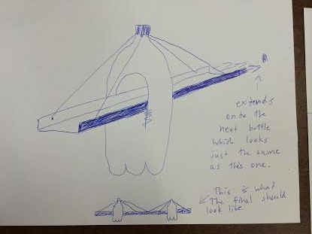

Slide 6
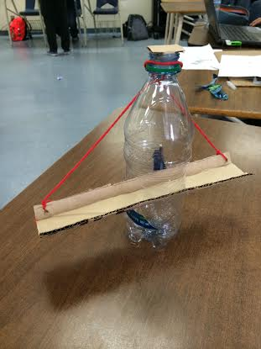
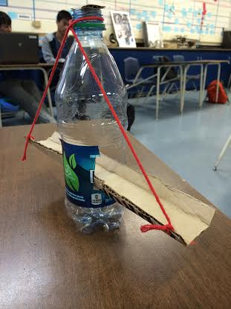
Small Scale Model

